Slide 1
Model selection
Lecture 2a

Slide 2
Overview
Model selection
Model evaluation

Slide 3
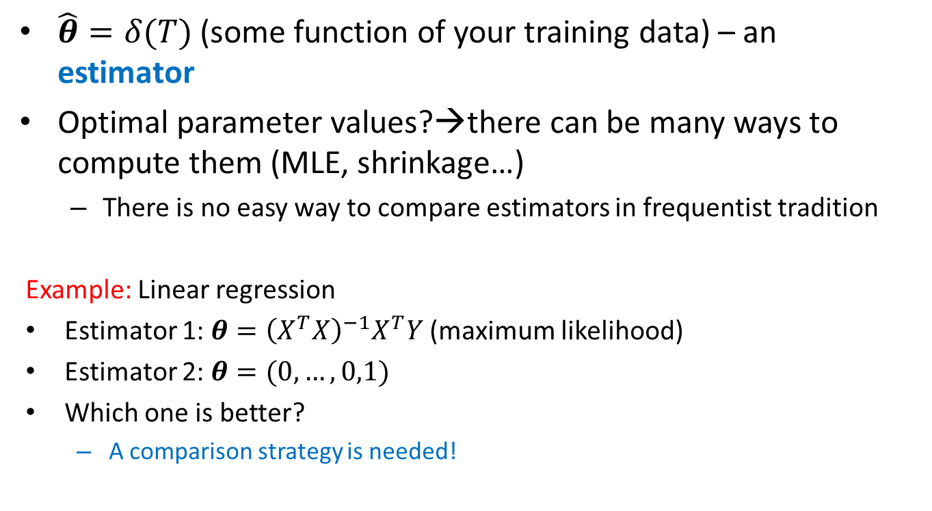
An estimator
$\hat{θ}=δ(T)$ (some function of your training data) – an estimator
Optimal parameter values?→there can be many ways to compute them (MLE, shrinkage…)
There is no easy way to compare estimators in frequentist tradition
Example: Linear regression
Estimator 1: $θ={\left(X^{T}X\right)}^{−1}X^{T}Y$ (maximum likelihood)
Estimator 2: $θ=(0,…,0,1)$
Which one is better?
A comparison strategy is needed!

Slide 4
Overfitting
Complex model can overfit your data
Too easy model, a few parameters
Proper one?
Complex model,
many parameters

Slide 5
Model selection
ML can lead to overfitting
How can we find appropriate parameter values?
How can we compare between different models?

Slide 6
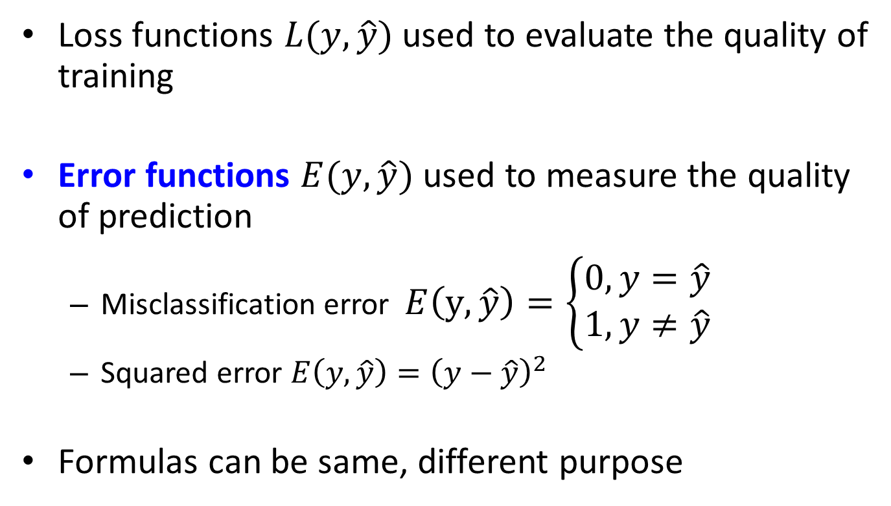
Error functions
Loss functions $L(y,\hat{y})$ used to evaluate the quality of training
Error functions $E(y, \hat{y})$ used to measure the quality of prediction
Misclassification error $E\left(y,\hat{y}\right)=\left\{\begin{matrix}0, y=\hat{y} \\ 1,y≠\hat{y}\end{matrix}\right.$
Squared error $E\left(y, \hat{y}\right)={\left(y−\hat{y}\right)}^{2}$
Formulas can be same, different purpose

Slide 7
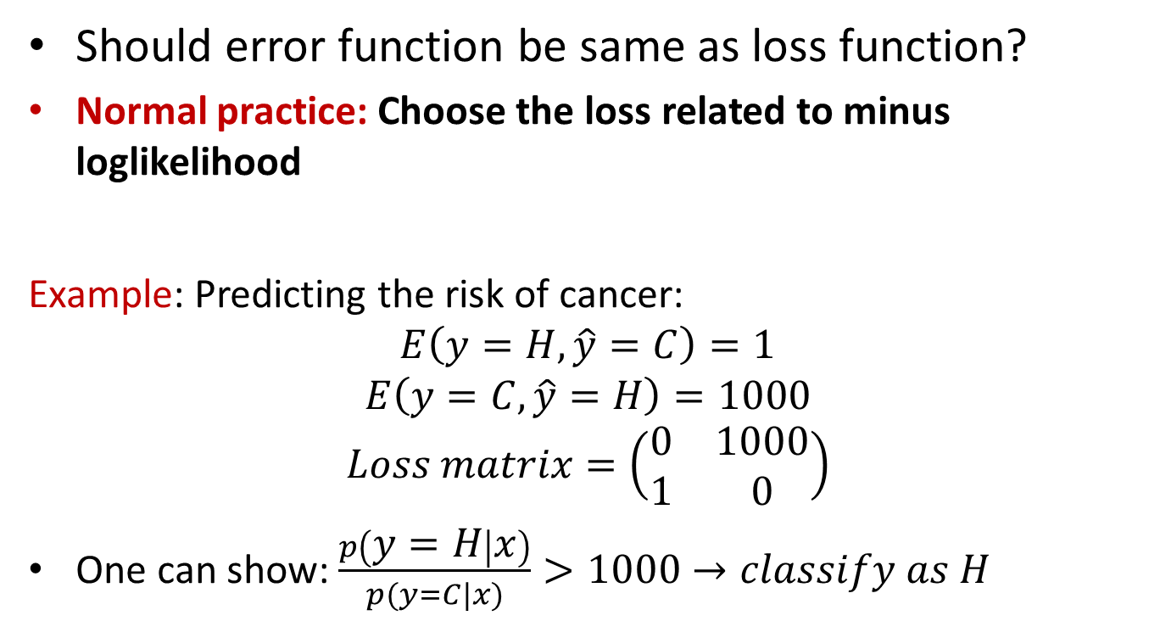
Error vs loss function
Should error function be same as loss function?
Normal practice: Choose the loss related to minus loglikelihood
Example: Predicting the risk of cancer:
$$E\left(y=H, \hat{y}=C\right)=1$$
$$E\left(y=C, \hat{y}=H\right)=1000$$
$$Loss matrix=\left(\begin{matrix}0 & 1000 \\ 1 & 0\end{matrix}\right)$$
One can show: $\frac{p\left(y=H | x\right)}{p(y=C|x)}>1000→classify as H$

Slide 8




Data generating process
$$y="Cat"$$
https://upload.wikimedia.org/wikipedia/commons/thumb/4/4d/Cat_November_2010-1a.jpg/1200px-Cat_November_2010-1a.jpg
Data generating process
$$p(x,y)$$
$$y="Dog"$$
https://www.collinsdictionary.com/images/full/dog_230497594.jpg

Slide 9

Model selection
Given a model, choose the optimal parameter values
Decision theory
If we know the true distribution $p(y,x)$ then we choose the optimal model by minimizing the expected risk:
$$\min_{\hat{y}}{{\overline{E}}_{new}}=\min_{θ}{\int_{\left(x_{∗},y_{∗}\right)}{\int_{T}{E\left(y_{∗},\hat{y}\left(x_{∗}, Τ, θ\right)\right)p\left(x_{∗},y_{∗}\right)dx_{∗}dy_{∗}}dT}}$$

Slide 10
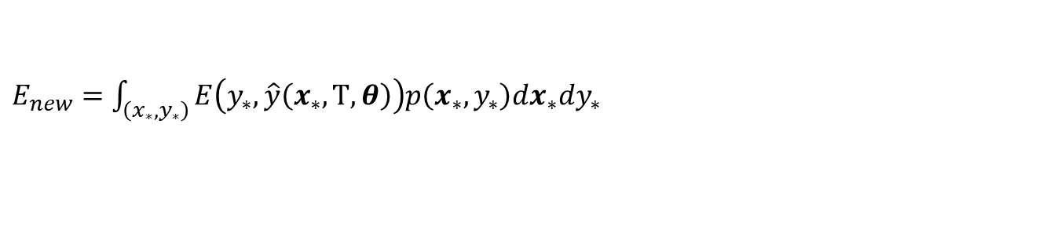
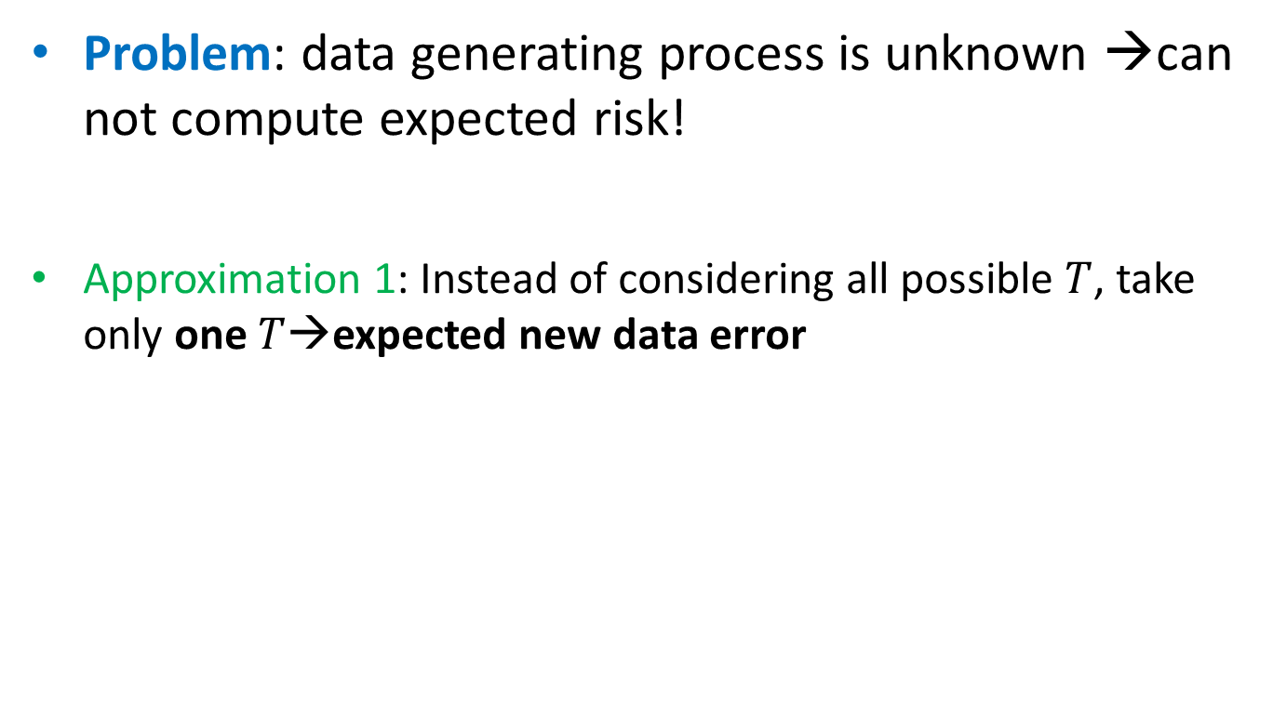
Model selection
Problem: data generating process is unknown →can not compute expected risk!
Approximation 1: Instead of considering all possible $T$, take only one $T$→expected new data error
$E_{new}=$ $\int_{\left(x_{∗},y_{∗}\right)}{E\left(y_{∗},\hat{y}\left(x_{∗}, Τ, θ\right)\right)p\left(x_{∗},y_{∗}\right)dx_{∗}dy_{∗}}$

Slide 11
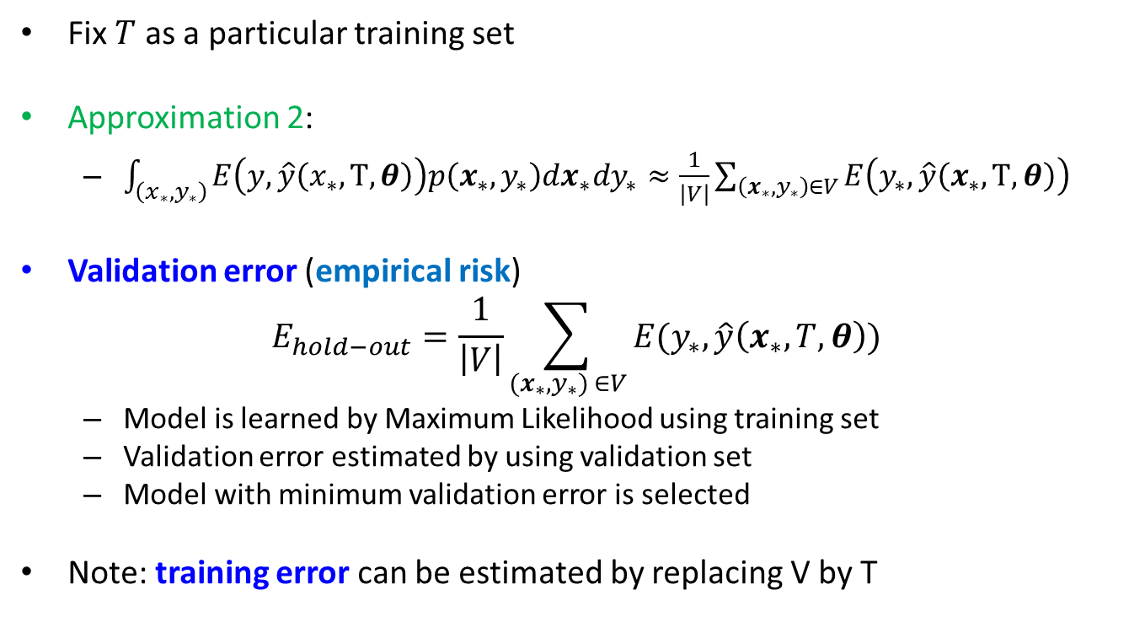
Hold-out method
Fix $T$ as a particular training set
Approximation 2:
$\int_{\left(x_{∗},y_{∗}\right)}{E\left(y,\hat{y}\left(x_{∗}, Τ, θ\right)\right)p\left(x_{∗},y_{∗}\right)dx_{∗}dy_{∗}≈\frac{1}{\left|V\right|}\sum_{\left(x_{∗},y_{∗}\right)∈V}{E\left(y_{∗},\hat{y}\left(x_{∗}, Τ, θ\right)\right)}}$
Validation error (empirical risk)
$$E_{hold−out}=\frac{1}{\left|V\right|}\sum_{(x_{∗},y_{∗}) ∈V}{E(y_{∗},\hat{y}\left(x_{∗},T, θ\right))}$$
Model is learned by Maximum Likelihood using training set
Validation error estimated by using validation set
Model with minimum validation error is selected
Note: training error can be estimated by replacing V by T

Slide 12



General model selection strategy
Given data $D=\left\{x_{i},y_{i}, i=1…n\right\}$
At learning step, Maximum Likelihood is usually used
$α_{i}$ can be different things:
Type of distribution
Number of variables in the model
Regulatization parameter value
…
Decide models
$$y\sim M(x,θ,α_{1})$$
$$y\sim M\left(x,θ,α_{2}\right)$$
…
Learning step
Fit models
$$y\sim M(x,\hat{θ},α_{1})$$
$$y\sim M\left(x,\hat{θ},α_{2}\right)$$
Decision step
Select model
..that minimizes the empirical risk

Slide 13
Hold-out method
Divide into training, validation and test sets
Choose proportions in some way
Training
Validation
Test

Slide 14
Hold-out method
Given: training, validation, test sets and models to select between
M1(?,?)
M2(?,?,?)
M3(?,?,?,?,?)
Training
Validation
Test

Slide 15
Hold-out method
Training set is to used for fitting models to the dataset by using given loss function
M1(a1,b1)
M2(a2,b2,c2)
M3(a3,b3,c3,d3,e3)
Training
Validation
Test

Slide 16
Hold-out method
Validation set is used to choose the best model (lowest risk)
Best!
M1(a1,b1)
M2(a2,b2,c2)
M3(a3,b3,c3,d3,e3)
Traning
Validation
Test

Slide 17
Hold-out method
Test set is used to test a performance on a new data
M2(a2,b2,c2)
Training
Validation
Test

Slide 18
Hold-out method
Easy model, a few parameters
OK
Complex model,
many parameters
minimum
Valid. error!

Slide 19
Hold-out method: remarks
Data needs to be shuffled before split
Method is suitable for large data otherwise training affected
Proportions: increasing % of training data generally leads to better performance but the quality of ”Approximation 2” decreases

Slide 20
Hold-out in R
How to partition into train/test?
Use set.seed(12345) in the labs to get identical results
How to partition into train/valid/test?
n=dim(data)[1]
set.seed(12345)
id=sample(1:n, floor(n*0.7))
train=data[id,]
test=data[-id,]
n=dim(data)[1]
set.seed(12345)
id=sample(1:n, floor(n*0.4))
train=data[id,]
id1=setdiff(1:n, id)
set.seed(12345)
id2=sample(id1, floor(n*0.3))
valid=data[id2,]
id3=setdiff(id1,id2)
test=data[id3,]

Slide 21
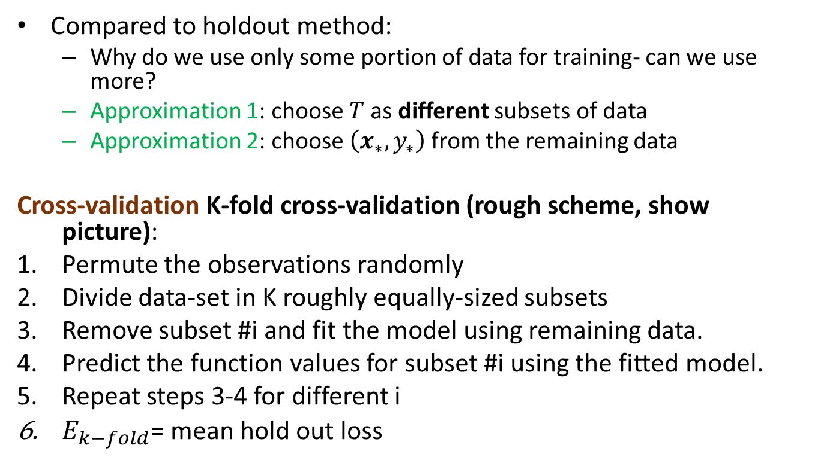
Cross-validation
Compared to holdout method:
Why do we use only some portion of data for training- can we use more?
Approximation 1: choose $T$as different subsets of data
Approximation 2: choose $\left(x_{∗},y_{∗}\right)$ from the remaining data
Cross-validation K-fold cross-validation (rough scheme, show picture):
Permute the observations randomly
Divide data-set in K roughly equally-sized subsets
Remove subset #i and fit the model using remaining data.
Predict the function values for subset #i using the fitted model.
Repeat steps 3-4 for different i
$E_{k−fold}$= mean hold out loss

Slide 22
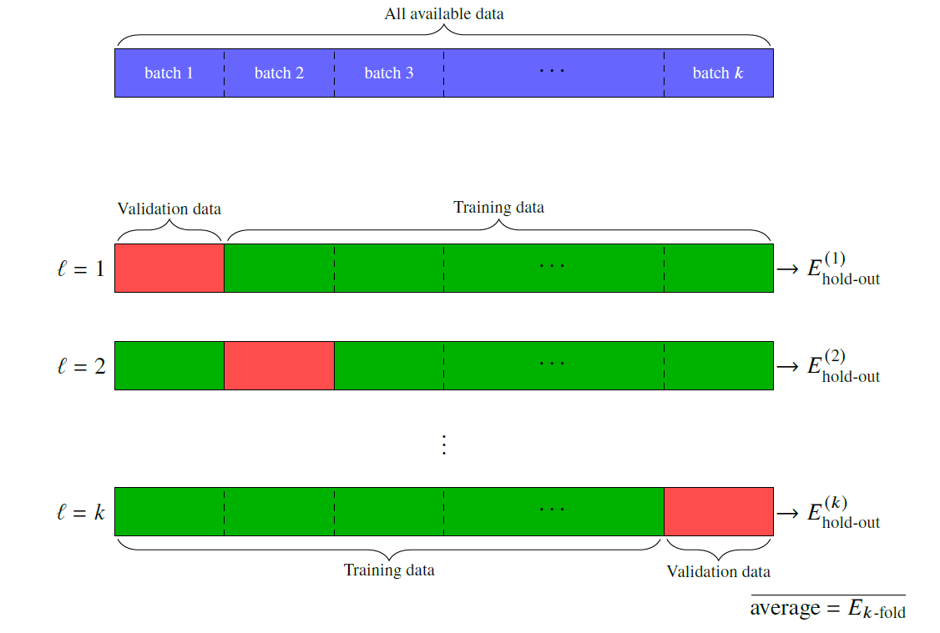
Cross-validation

Slide 23

Cross-validation
Cross-validation
$E_{k−fold}$ is used as approximation of $E_{new}$
Note: if k=n then method is leave-one-out cross-validation.
What to do if n is not a multiple of k?

Slide 24
Cross-validation vs Holdout
Holdout is easy to do (one model fit)
Cross validation is computationally demanding (many model fits)
Holdout is applicable for large data
Otherwise, model selection performs poorly
Cross validation is more suitable for smaller data
In both cases, test set gives unbiased prediction error

Slide 25
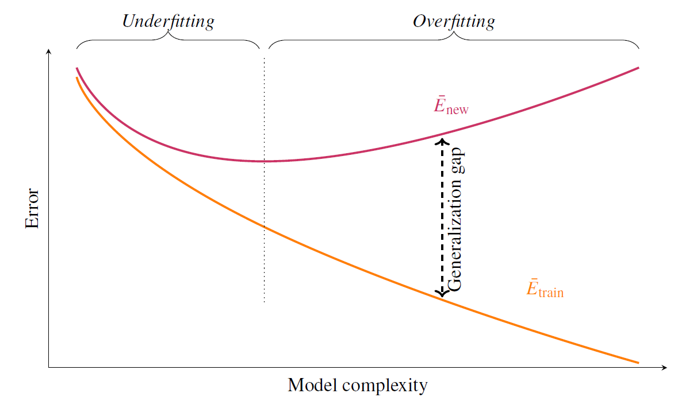

Model selection
Dependence on model complexity
${\overline{E}}_{new}=\int_{\left(x_{∗},y_{∗}\right)}{\int_{T}{E\left(y_{∗},\hat{y}\left(x_{∗}, Τ, θ\right)\right)p\left(x_{∗},y_{∗}\right)dx_{∗}dy_{∗}}dT}$
${\overline{E}}_{train}=\int_{T}{\int_{\left(x_{∗},y_{∗}\right)∈T}{E\left(y_{∗},\hat{y}\left(x_{∗}, Τ, θ\right)\right)dx_{∗}dy_{∗}}dT}$

Slide 26
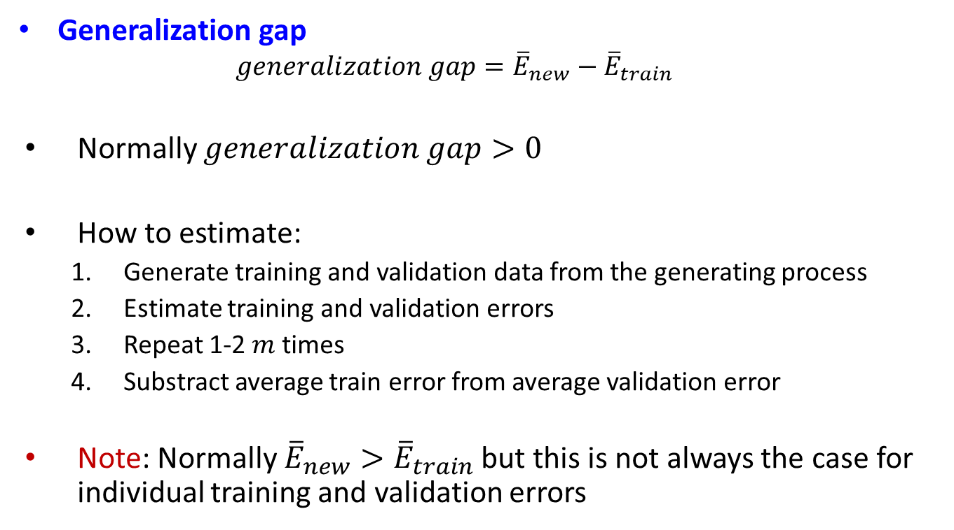
Model selection
Generalization gap
$$generalization gap={\overline{E}}_{new}−{\overline{E}}_{train}$$
Normally $generalization gap>0$
How to estimate:
Generate training and validation data from the generating process
Estimate training and validation errors
Repeat 1-2 $m$ times
Substract average train error from average validation error
Note: Normally ${\overline{E}}_{new}>{\overline{E}}_{train}$ but this is not always the case for individual training and validation errors

Slide 27
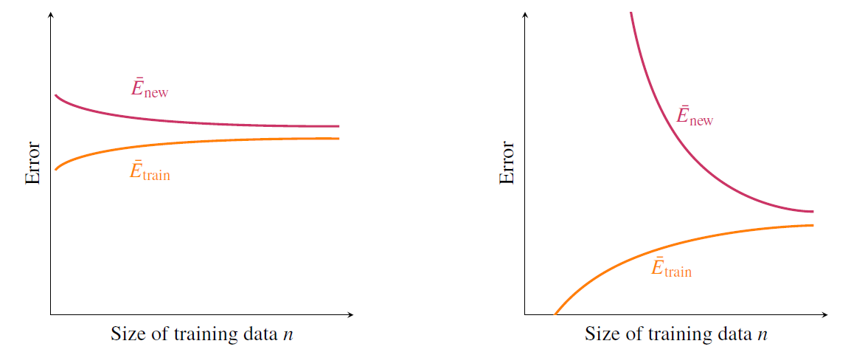
Model selection
Dependence of data size

Slide 28
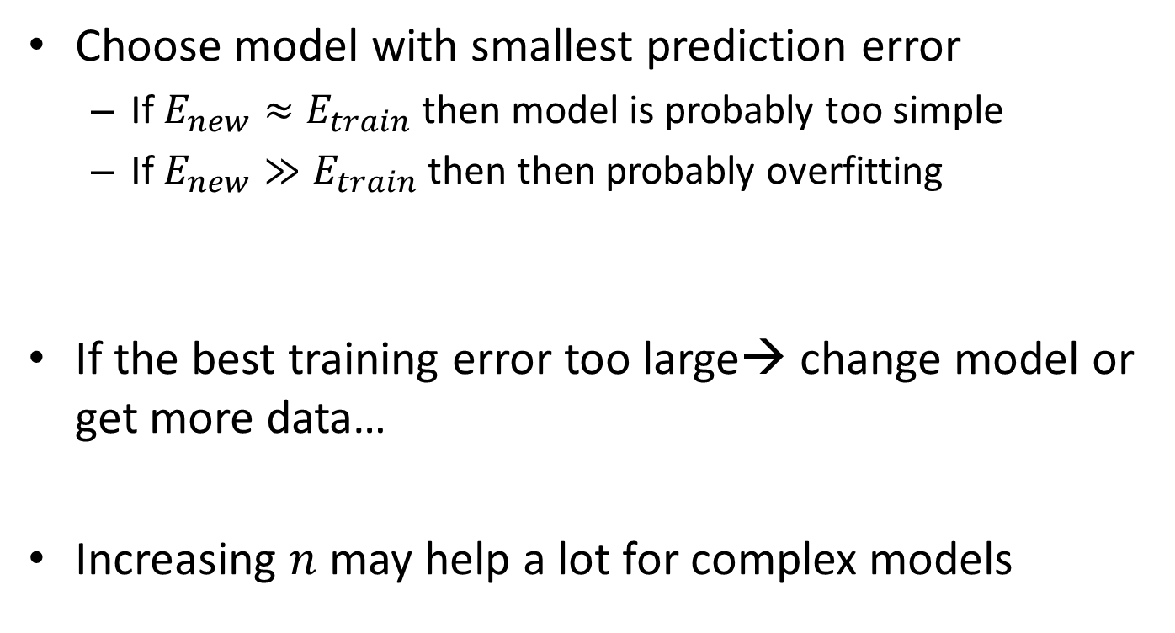
Model selection: comments
Choose model with smallest prediction error
If $E_{new}≈E_{train}$ then model is probably too simple
If $E_{new}≫E_{train}$ then then probably overfitting
If the best training error too large→ change model or get more data…
Increasing $n$ may help a lot for complex models

Slide 29
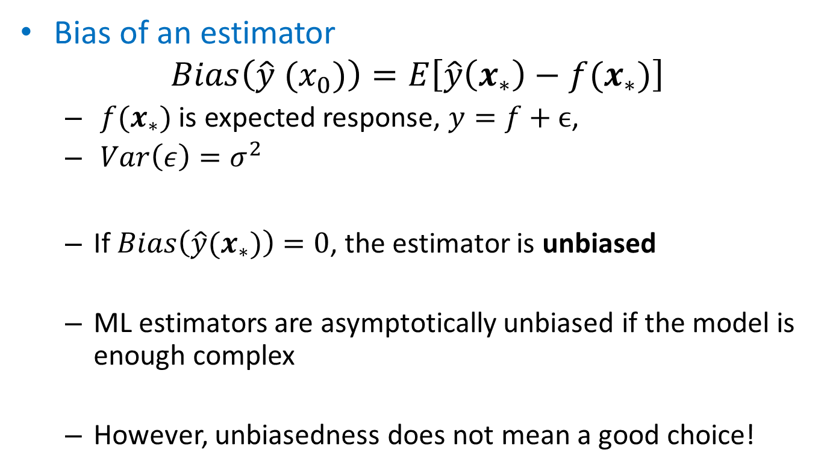
Bias-variance tradeoff
Bias of an estimator
$$Bias\left(\hat{y} (x_{0})\right)=E\left[\hat{y}\left(x_{∗}\right)−f(x_{∗})\right]$$
$f(x_{∗})$ is expected response, $y=f+ϵ$,
$Var\left(ε\right)=σ^{2}$
If $Bias\left(\hat{y}(x_{∗})\right)=0$, the estimator is unbiased
ML estimators are asymptotically unbiased if the model is enough complex
However, unbiasedness does not mean a good choice!

Slide 30
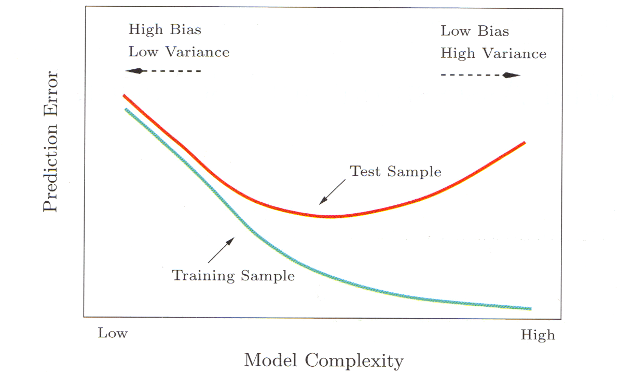

Bias-variance tradeoff
Assume error function is $E\left(y, \hat{y}\right)={\left(y−\hat{y}\right)}^{2}$
$${\overline{E}}_{new}\left(y\left(x_{∗}\right),\hat{y}\left(x_{∗}\right)\right)=σ^{2}+Bias^{2}\left(\hat{y}\left(x_{∗}\right)\right)+Var(\hat{y}\left(x_{∗}\right))$$
When error is not quadratic, no such nice formula exist

Slide 31
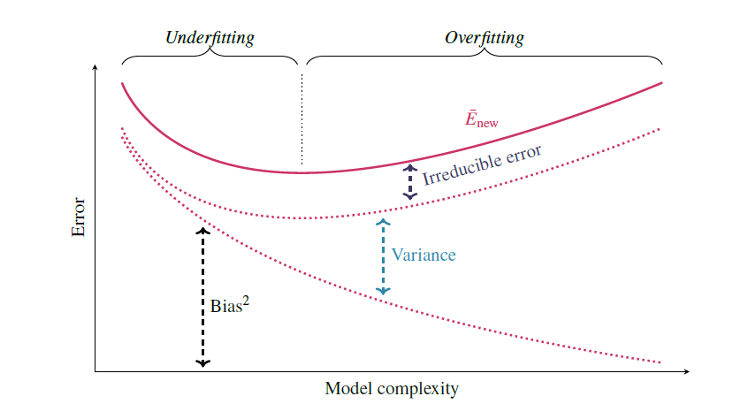
Bias-variance tradeoff
Individual contributions

Slide 32
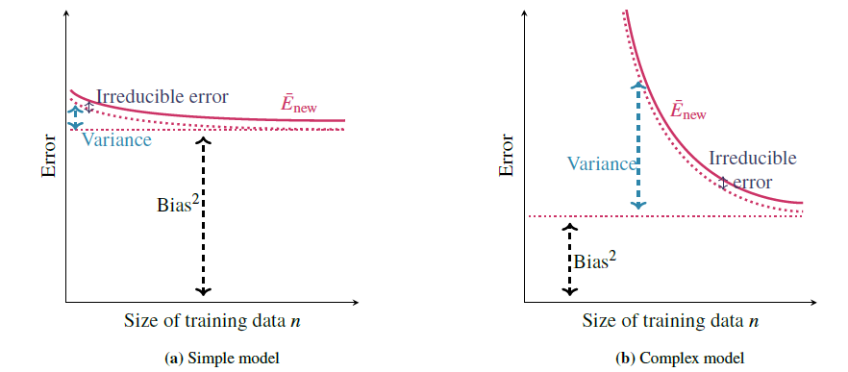

Bias-variance tradeoff
Influence of $n$

Slide 33

Model selection
Example Computer Hardware Data Set : performance measured for various processors and also
Cycle time
Memory
Channels
…
Build model predicting performance

Slide 34
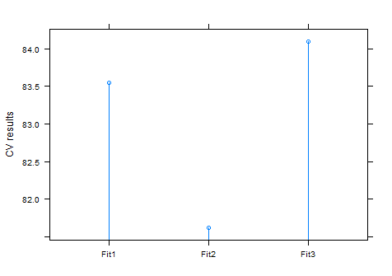
Cross-validatation
Try models with different predictor sets
data=read.csv("machine.csv", header=F)
library(cvTools)
fit1=lm(V9~V3+V4+V5+V6+V7+V8, data=data)
fit2=lm(V9~V3+V4+V5+V6+V7, data=data)
fit3=lm(V9~V3+V4+V5+V6, data=data)
f1=cvFit(fit1, y=data$V9, data=data,K=10, foldType="consecutive")
f2=cvFit(fit2, y=data$V9, data=data,K=10, foldType="consecutive")
f3=cvFit(fit3, y=data$V9, data=data,K=10, foldType="consecutive")
res=cvSelect(f1,f2,f3)
plot(res)

Slide 35

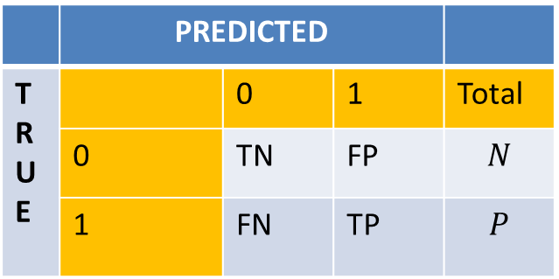
Model evaluation
Binary classification
The choice of the thershold $p\left(y=1|x\right)>r→classify "1"$ affects prediction→which classifier is better?
Confusion matrix
 | PREDICTED
T R U E |  | 0 | 1 | Total
 | 0 | TN | FP | $$N$$
 | 1 | FN | TP | $$P$$

Slide 36
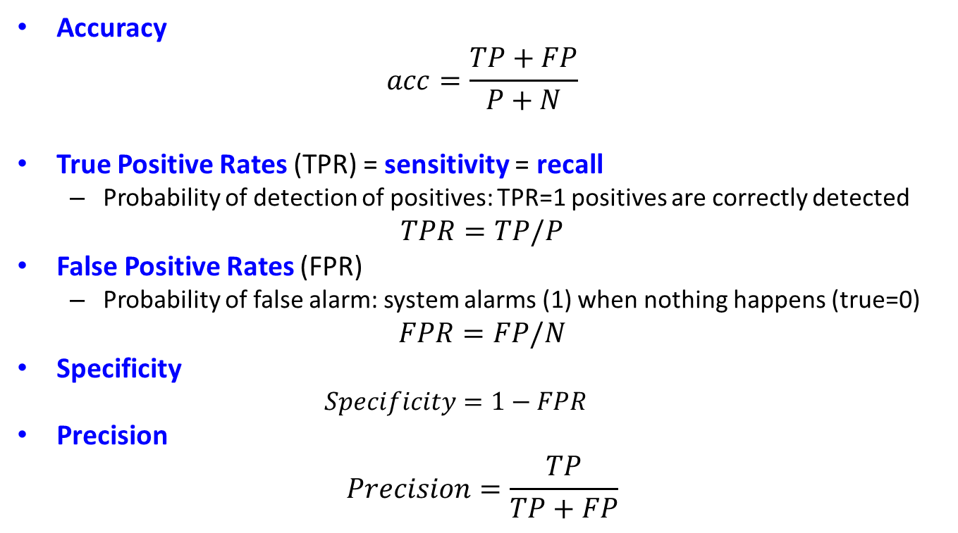
Model evaluation
Accuracy
$$acc=\frac{TP+FP}{P+N}$$
True Positive Rates (TPR) = sensitivity = recall
Probability of detection of positives: TPR=1 positives are correctly detected
$$TPR=TP/P$$
False Positive Rates (FPR)
Probability of false alarm: system alarms (1) when nothing happens (true=0)
$$FPR=FP/N$$
Specificity
$$Specificity=1−FPR$$
Precision
$$Precision=\frac{TP}{TP+FP}$$

Slide 37
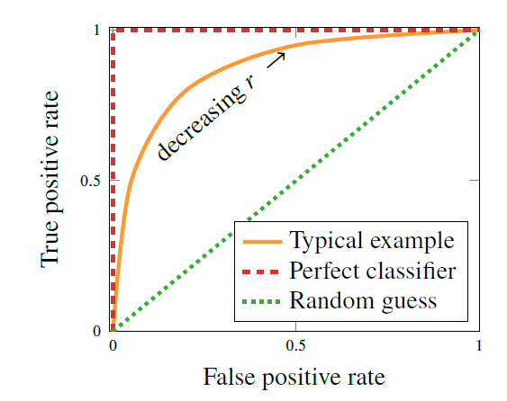
ROC curves
ROC=Receiver operating characteristics
Use various thresholds, measure TPR and FPR
Same FPR, higher TPR→ better classifier
Best classifier = greatest Area Under Curve (AUC)

Slide 38
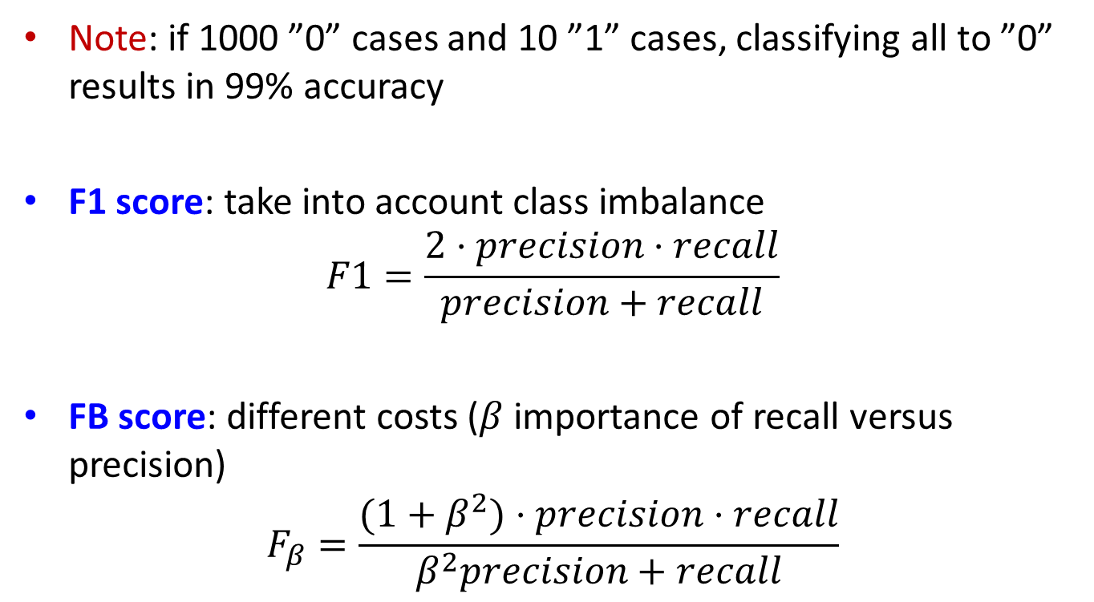
Imbalanced classes
Note: if 1000 ”0” cases and 10 ”1” cases, classifying all to ”0” results in 99% accuracy
F1 score: take into account class imbalance
$$F1=\frac{2⋅precision⋅recall}{precision+recall}$$
FB score: different costs ($β$ importance of recall versus precision)
$$F_{β}=\frac{(1+β^{2})⋅precision⋅recall}{β^{2}precision+recall}$$

Slide 39
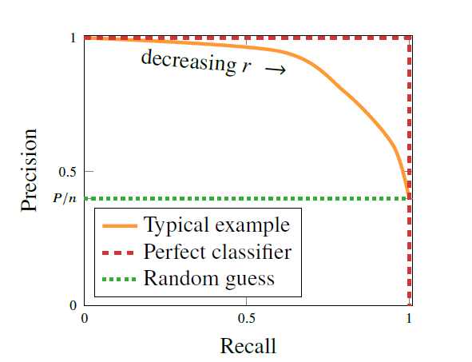
Imbalanced classes: precision-recall curve
Better than ROC for imbalanced classes

